Slide 1
Testing throughout the SDLC
SE401: Software Quality Assurance and Testing

Slide 2
Outline
Software development models
Test Levels
Test Types
Maintenance testing

Slide 3
Software development models
Testing is important in the software development life cycle
The life cycle model will determine how to organize the testing
Testing is highly related to software development activities

Slide 4
Testing is focused on…
Verification
Is the deliverable built according to the specifications?
Validation
Is the deliverable fit for purpose, e.g. does it provide a solution to the problem?

Slide 5
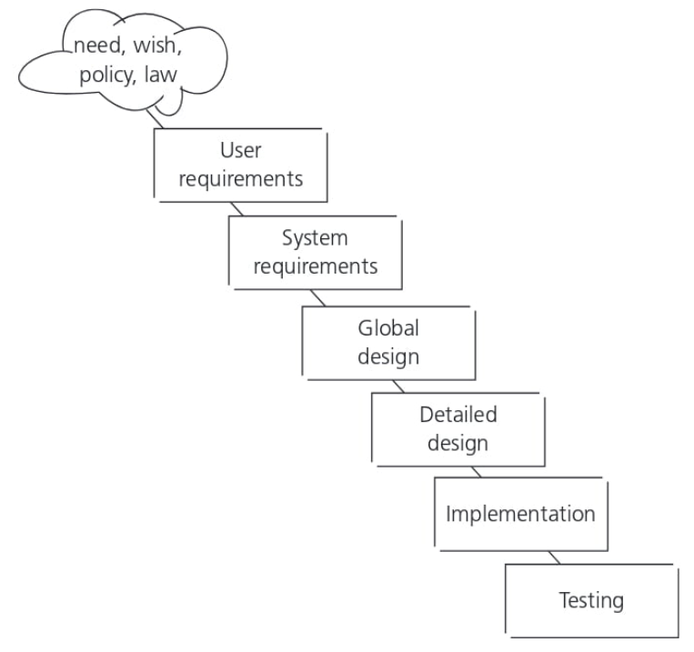
Waterfall model

Slide 6
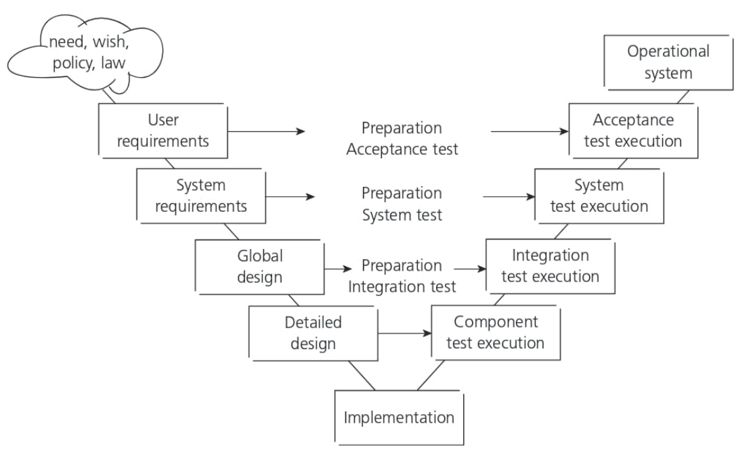
The V-model

Slide 7
The V model
Testing needs to begin as early as possible in the life cycle.
Testing can be integrated into each phase of the life cycle.
Within the V-model, validation testing takes place especially during
the early stages ,i.e. reviewing the user requirements
and late in the life cycle, i.e. during user acceptance testing

Slide 8
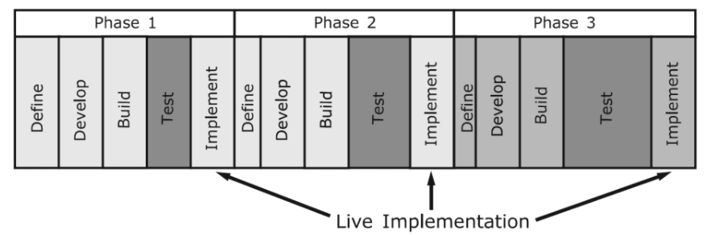
Iterative-incremental development model
Iterative-incremental development is the process of establishing requirements, designing, building and testing a system carried out as a series of shorter development cycles.
An increment, added to others developed previously, forms a growing partial system, which should also be tested.
Regression testing is increasingly important to all iteration phases after the first one.

Slide 9
Testing within a life cycle model
In any life cycle model, there are several characteristics of good testing:
Test levels can be combined or reorganized depending on the nature of the project or the system architecture
Every development activity has a corresponding testing activity
Each test level has test objectives specific to that level.
The analysis & design of tests for a given test level should begin during the corresponding development activity
Testers should be involved in reviewing documents as soon as drafts are available in the development life cycle

Slide 10
Testing within a life cycle model

Slide 11
Test Levels
Acceptance: is the responsibility of the customer – in general. The goal is to gain confidence in the system
Unit: Any module, program, object separately testable
System: The behavior of the whole product as defined by the project scope
Integration: Interfaces between components ; interactions with other systems (OS, HW, ..)

Slide 12
Test Levels
For each test level, please note:
The generic objectives
The test basis (docs/products used to derive test cases)
The test objects (what is being tested)
Typical defects and failures to be found
Specific approaches and responsibilities

Slide 13
Component testing - objectives
Verifying the functioning of software items (modules, methods, objects, classes etc.) that are separately testable
Component testing includes testing of functionality and specific non functional characteristics, such as:
resource behavior (e.g. memory leaks)
robustness testing
structural testing (e.g. branch coverage).

Slide 14
Component testing - test basis
All materials that are applicable for the component under test:
Specification of the component
Software design
The data model
As well as the code itself

Slide 15
Component testing
Writing code to test the project code
Stubs, drivers and simulators may be used.
Stubs:
Code that replaces a called component in order to simulate its purpose (i.e. "hard-coded" data to replace data from a database).
Drivers:
Code that replaces an other software component in order to call the component under test.

Slide 16
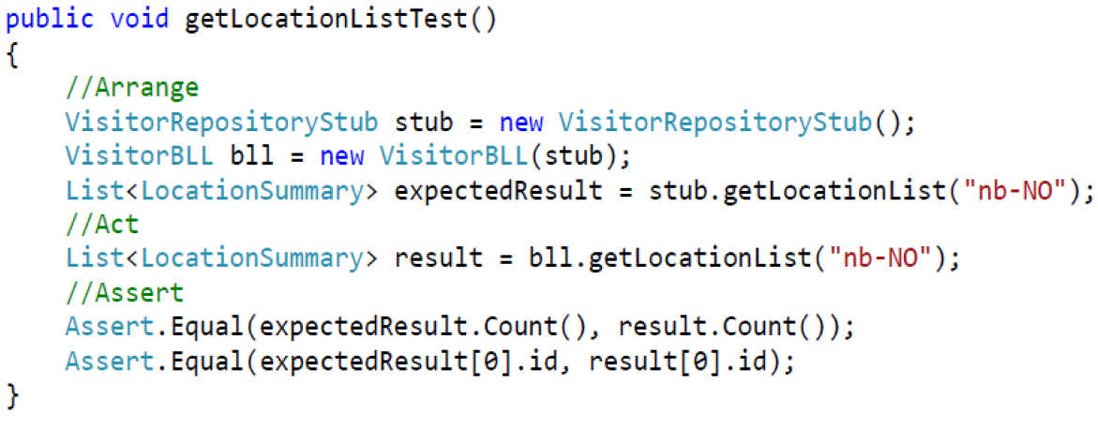
Component testing - example

Slide 17
Component testing - approaches and responsibilities
Component testing usually involves the programmer who wrote the code.
Defects are fixed as soon as they are found, without formal recording of incidents.
TDD test-driven development
prepare and automate test cases before coding
used in XP (extreme programming)

Slide 18
Integration testing - objectives
Tests interfaces between components
Test interactions with different parts of a system, such as:
the operating system
file system
hardware
interfaces between systems

Slide 19
Integration testing - test basis
Software and system design
The system architecture
Workflows/use cases

Slide 20
Integration testing - test objects
The item under test includes
Builds including some or all component of the system
The database elements
System infrastructure
Interface between components or objects
System configuration
Configuration data

Slide 21
Integration testing - types
Component integration
Tests the interactions between software components is done after component testing
System integration
Tests the interactions between different systems is done after system testing.

Slide 22
Integration testing - approaches and responsibilities
Start integration with those components that are expected to cause most problems.
To reduce the risk of late defect discovery, integration should normally be incremental rather than “big bang”.
Both functional and structural approaches may be used.
Ideally, testers should understand the architecture and influence integration planning.
Can be done by the developers or by a separate team.

Slide 23
System testing - objectives
Testing the behavior of the whole system as defined by the scope of the project.

Slide 24
System testing - test basis
System requirements specification , both functional and non functional
Business processes
Risk analysis
Use cases
Other high level descriptions of the system behavior, interactions with OS/system resources
Requirements may exist as text and/or models.
Testers also need to deal with incomplete or undocumented requirements.

Slide 25
System testing - test objects
The entire integrated system
User manuals
Operation manuals
System configuration information
Configuration data

Slide 26
System testing - approaches and responsibilities
Test environment should correspond to the production environment as much as possible.
First, the most suited black-box technique
Then, white-box technique to assess the thoroughness of testing
An independent test team may be responsible for the testing
The level of independence is based on the applicable risk level

Slide 27
Acceptance testing - objectives
The questions to be answered:
Can the system be released?
What are the outstanding risks?
Has development met its obligations?
The goal is to establish confidence in
The system
Non-functional characteristics of the system

Slide 28
Acceptance testing - test basis
User requirements specification
Use cases
System requirements specification
Business processes
Risk analysis

Slide 29
Acceptance testing - types
User acceptance testing –validate the fitness for use of the system by users.
Operational testing, usually done by the system administrators:
testing of backup/restore
disaster recovery
user management
maintenance tasks
periodic checks of security vulnerabilities

Slide 30
Acceptance testing - types
Contract and regulation acceptance testing performed against a contract’s acceptance criteria (i.e. governmental, legal or safety regulations)
Alpha and beta testing
Alpha testing is performed at the developing organization’s site.
Beta testing (field testing), is performed by people at their own locations.
Both are performed by potential customers, not the developers of the product.

Slide 31
Acceptance testing - responsibilities
Customers or users of a system
Stakeholders may be involved

Slide 32
Test Types
“What” the system does:
Suitability
Interoperability
Security
Accuracy
Compliance
“How” the system works:
Performance, Load, Stress
Reliability
Usability
Efficiency
Maintainability
Portability
Functional
Non-Functional
Structural
Related to Changes
Confirmation Testing
Regression Testing
Code Coverage

Slide 33
Functional testing (Black box testing)
Objectives
Test what a system should do and consider the external behavior of the software.
Test levels
May be performed at all test levels
Test basis
The expected behavior description can be found in work products such as:
requirements specification
business processes
use cases
functional specifications
may be undocumented

Slide 34
Non functional testing
Objectives
Measuring characteristics of software that can be quantified on a varying scale: e.g. response times for performance testing
Test levels
May be performed at all test levels
You can find more about them in ‘Software Engineering –Software Product Quality’ (ISO 9126).

Slide 35
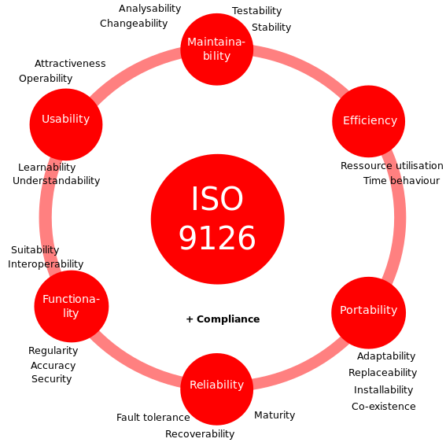
Software Product Quality

Slide 36
Structural testing (white box testing)
Objectives
Measuring the thoroughness of testing through assessment of the coverage of a set of structural elements or coverage items.
Test levels
May be performed at all test levels, but especially in component testing and component integration testing.

Slide 37
Structural testing (white box testing)
Test basis
Structural testing is based on the structure of the code as well as the architecture of the system (e.g. a calling hierarchy, a business model or a menu structure)
Approach
Structural techniques are best used after specification-based techniques, in order to help measure the thoroughness of testing.
Tools
Coverage measurement tools assess the percentage of executable elements(e.g. statements or decision outcomes) that have been exercised.

Slide 38
Testing related to changes, confirmation and regression testing
Confirmation testing
After a defect is detected and fixed, the software should be retested to confirm that the original defect has been successfully removed.
Regression testing
The repeated testing of an already tested program, after modification, to discover any defects introduced or uncovered as a result of the change(s).

Slide 39
Testing related to changes
Objective
To verify that modifications in the software or the environment have not caused unintended side effects and that the system still meets its requirements.
Test levels
May be performed at all test levels, applies to functional, non-functional and structural testing.

Slide 40
Testing related to changes
Approach
The extent of regression testing is based on the risk of finding defects in software that was working previously.
Regression test suites are run many times and generally evolve slowly, so regression testing is a strong candidate for automation.
If the regression test suite is very large it may be more appropriate to select a subset for execution.

Slide 41
Maintenance testing
Objectives
Maintenance testing is done on an existing operational system , and is triggered by modifications migration, or retirement of the software or system.

Slide 42
Maintenance testing - types
Modifications
Planned enhancement changes(e.g. release-based)
Corrective and emergency changes (patches)
Changes of environment (operating system or database upgrades)
Migration (e.g. from one platform to another)
operational tests of the new environment
tests on the changed software.
Retirement of a system
The testing of data migration or archiving if long data-retention periods are required.

Slide 43
Maintenance testing
Scope
The scope of maintenance testing is related to:
the risk of the change
the size of the existing system
the size of the change
Test levels
Depending on the changes, maintenance testing may be done at any or all test levels and for any or all test types.

Slide 44
Maintenance testing
Approach
Determining how the existing system may be affected by changes is called impact analysis, and is used to help decide how much regression testing to do.
Note
Maintenance testing can be difficult if specifications are out of date or missing.

